Slide 1

Image and Video Captioning Using Deep Learning
SWE1904_REVIEW-3
19MIS1018
B DEVI PRASAD
Guide: Dr. Revathi(52287)

Slide 2
Outline
Abstract
Introduction
Literature Review
Scope and Problem Statement
Algorithm/Methodology
Results and Discuusion
Guide Approval Mail Snapshot
References

Slide 3
Abstract
Image/Video captioning has made attractive progress in detecting and captioning all events in a long untrimmed video. Image/Video captioning aims to describe named entities and events related to the image/video by utilizing the background knowledge. The process of understanding a video/image and generating descriptive text for it is known as video captioning. Video captioning requires not only understanding the visual content but also producing human-like descriptions that accurately capture its semantics. Achieving this level of understanding requires the collaborative efforts of both the computer vision and natural language processing research communities. The captions produced through video captioning serve as valuable resources that can be further leveraged for various applications such as video search, accessibility for visually impaired people, and human-robot interaction. Deep learning strategies have emerged as powerful tools in addressing the complexities of video and image captioning.

Slide 4
Introduction
The computer vision have lead significant breakthroughs in image and video analysis. One such pivotal application is the field of image and video captioning, where the goal is to generate descriptive and contextually relevant textual captions for images and videos.
This uses deep learning and knowledge graphs to enhance the contextuality of image and video captions.
Image captioning has more challenging, as it requires understanding visual content and events’ temporal dynamics. Deep learning methods such as Convolutional Neural Networks (CNNs), Recurrent Neural Networks (RNNs), Long-Short Term Memory(LSTM) and Knowledge Graphs (KGs) have been used to achieve significant improvements in image/video captioning.

Slide 5
Introduction Cont’d
Image and video captioning play a crucial role in bridging the gap between visual content and textual understanding. By automatically generating captions, machines can provide meaningful insights into the content of images and videos, making them more accessible and understandable to users.
The artificial intelligence and knowledge graphs will help us to get the captioning of Image/Video Captioning’s.
Image and video captioning are related but distinct tasks in computer vision and natural language processing.

Slide 6
Literature Survey
S.NO | NAME OF THE PAPER | AUTHORS,PUBLISHER AND ALGORITHMS USED | MECHANISM USED
1. | Exploring deep learning approaches for video captioning: A comprehensive review | Adel Jalal Yousif a, Mohammed H. Al-Jammas Elsevier, 2023 (CNN+GRU) | Deep learning based methods for video captioning, highlighting their key components, challenges, and recent advancements.
2. | Deep learning and knowledge graph for image/video captioning: A review of datasets, evaluation metrics, and methods | Mohammad Saif Wajid, Hugo Terashima-Marin, Peyman Najafirad, Mohd Anas Wajid. WILEY, 2023 Knowledge Graph | Deep learning and knowledge graph-based approaches), benchmark datasets, and evaluation metrics with their benefits, limitations and the image/video captioning and their applications in the current scenario.

Slide 7
Literature Survey
S.NO | NAME OF THE PAPER | AUTHORS,PUBLISHER AND ALGORITHMS USED | MECHANISM USED
3. | CPTR: FULL TRANSFORMER NETWORK FOR IMAGE CAPTIONING | Wei Liu, Sihan Chen, Longteng Guo, Xinxin Zhu , Jing Liu IEEE, 2021 Transformer Networks | This paper provides the image captioning task from a new sequence-to-sequence prediction perspective and pro_x0002_pose CaPtion TransformeR (CPTR) and provide detailed visual_x0002_izations of the self-attention between patches in the encoder and the “words-to-patches” attention in the decoder
4. | Video captioning using transformer network | Mubashira I. Nechikkat, Bhagyasree V. Pattilikattil, Soumya Varma Conference, 2022 LSTM+RNN | This paper introduces transformer based network architecture over LSTM based models for captioning video. This architecture is generally used in language translation models. Transformer network contains multi-head self-attention and the encoder-decoder attention to improve the performance of text description generation.

Slide 8
Literature Survey
S.NO | NAME OF THE PAPER | AUTHORS,PUBLISHER AND ALGORITHMS USED | MECHANISM USED
5. | Text with Knowledge Graph Augmented Transformer for Video Captioning | Xin Gu1,Guang Chen, Yufei Wang, Libo Zhang, Tiejian Luo, Longyin Wen IEEE, 2023 CNN+KG | This paper, proposes a text with knowledge graph augmented transformer (TextKG) for video captioning. Notably, TextKG is a two-stream trans_x0002_former, formed by the external stream and internal stream.
6. | Boosting Entity-aware Image Captioning with Multi-modal Knowledge Graph | Wentian Zhao , Yao Hu , Heda Wang , Xinxiao Wu10, and Jiebo Luo IEEE, 2023 Knowledge Graph | Image captioning aims to describe named entities and events related to the image by utilizing the back_x0002_ground knowledge. , the multi-modal knowl_x0002_edge graph is integrated into the captioning model via a graph attention mechanism. Extensive experiments on both GoodNews and NYTimes800k datasets demonstrate the effectiveness of our method.

Slide 9
Literature Survey
S.NO | NAME OF THE PAPER | AUTHORS,PUBLISHER AND ALGORITHMS USED | MECHANISM USED
7. | Leveraging Weighted Fine-Grained Cross-Graph Attention for Visual and Semantic Enhanced Video Captioning Network | Deepali Verma, Arya Haldar, Tanima Dutta (AAAI-23) CNN | The proposed network achieves promising results on three benchmark datasets: YouTube2Text, MSR-VTT, and VATEX. The experimental results show that our network accurately captures all key objects, relationships, and se_x0002_mantically enhanced events of a video to generate human annotation-like captions.
8. | Bidirectional transformer with knowledge graph for video captioning | Maosheng Zhong, Youde Chen Springer, 2023 LSTM + GAN | Experiments on two mainstream benchmark datasets, i.e., MSVD and MSR-VTT, demonstrate the effectiveness of BTKG, which achieves state-of-the-art performance in significant metrics. Moreover, the sentences generated by BTKG contain scene words and modifiers, that are more in line with human language habits.

Slide 10
Literature Survey
S.NO | NAME OF THE PAPER | AUTHORS,PUBLISHER AND ALGORITHMS USED | MECHANISM USED
9. | Automatic Image and Video Caption Generation With Deep Learning: A Concise Review and Algorithmic Overlap | SOHEYLA AMIRIAN , KHALED RASHEED, THIAB R. TAHA , AND HAMID R. ARABNIA IEEE-2020 Transformer Network CNN | it is a concise review of both image captioning and video captioning methodologies based on deep learning. This study treats both image and video captioning by emphasizing the algorithmic overlap between the two.
10. | Dense Video Captioning using BiLSTM Encoder | Jyoti Madake, Shripad Bhatlawand, Swarali Purandare, Swati Shilaskar, Yash Nikhare IEEE - 2022 Neural Networks | BILSTM encoder effectively utilizes both past and future contexts from the video for generating captions. This model is trained and tested on MSVD dataset which has around 2000 videos and their corresponding captions. The proposed framework shows increased accuracy in video captioning in terms of BLEU score 0.78 and METEOR score 0.34.

Slide 11
Literature Survey
S.NO | NAME OF THE PAPER | AUTHORS,PUBLISHER AND ALGORITHMS USED | MECHANISM USED
11. | Image Captioning Using CNN and RNN | S Rohitharun, L Uday Kumar Reddy, S Sujana Asian Conference[IEEE- 2022] CNN+RNN | The activities being done, the interaction between the elements, and so on. Automatic Caption Generator employing CNN and RNN-LSTM models is described in this work. It integrates contemporary machine translation and computer vision research. Flickr8k was utilised as a dataset.
12. | Modeling graph-structured contexts for image captioning | Jiahui Wei , Feicheng Huang a, Huifang Ma b. ELSEVIER - 2023 GCN | Deep neural network architectures combining with attention mechanisms and reinforcement learning optimization. Exploring visual relationships and interactions between different objects appearing in the image. a Graph Convolutional Network (GCN) is employed to acquire relationship knowledge by aggregating the information of its local neighbors. As we train the captioning model, we feed the potential relation-aware information into the Transformer to generate descriptive sentence.

Slide 12
Literature Survey
S.NO | NAME OF THE PAPER | AUTHORS,PUBLISHER AND ALGORITHMS USED | MECHANISM USED
13. | Visual Commonsense-aware Representation Network for Video Captioning | Pengpeng Zeng, Haonan Zhang, Lianli Gao, Xiangpeng Li, Jin Qian and Heng Tao Shen, Fellow, IEEE-2021 A Streamlined approach C3D+GRU+RNN | Visual Commonsense-aware Representation Network (VCRN), for video captioning. Specifically, a Video Dictionary, a plug_x0002_and-play component, obtained by clustering all video features from the total dataset into multiple clustered centers withoutadditional annotation. Each center implicitly represents a visual commonsense concept in the video domain, which is utilized our proposed Visual Concept Selection (VCS) to obtain a video_x0002_related concept feature.
14. | Prompt Learns Prompt: Exploring Knowledge-Aware Generative Prompt Collaboration for Video Captioning | Liqi Yan, Cheng Han, Zenglin Xu, Dongfang Liu and Qifan Wang. IJCAI-23 CNN+RNN | Experimental results show the superior performance of our approach over several state-of-the-art baselines. We further demonstrate that the video-language prompts are well learned from the knowledge_x0002_aware prompts

Slide 13
Literature Survey
S.NO | NAME OF THE PAPER | AUTHORS,PUBLISHER AND ALGORITHMS USED | MECHANISM USED
15. | Multimodal feature fusion based on object relation for video captioning | Zhiwen Yan, Ying Chen, Jinlong Song, Jia Zhu WILEY, 2021 CNN+C3D | [MSR‐VTT]) demonstrate the Video captioning aims at automatically generating a natural language caption to describe the content of a video.Most of the existing methods in the video captioning task ignore the relationship between objects in the video and the correlation between multimodal features, and they also ignore the effect of caption length on the task. This study proposes a novel video captioning framework(ORMF) based on the object relation graph and multimodal feature fusion.

Slide 14
Scope
Implementing the Deep learning models for both image and video captioning. This involves training models to understand and describe the content of images and videos in generating the caption.
Integrate semantic information from the knowledge graph to enrich the generated captions. This can involve identifying and incorporating entities, relationships, and concepts related to the content to be generated.
To Develop a interface to demonstrate the captioning system. Users should be able to upload images or videos and receive descriptive captions enriched with knowledge graph information.

Slide 15
Problem Statement
Based on the content of an Image and Video, this application will generate a caption for any natural image. Such an application might help blind people to see the world full with images. This model automatically generates natural language captions which then can be utilized for indexing and searching of images, tagging in social media, helping the visually impaired etc. The uses of such an application is immense. In this paper, we will build such an application using Convolution Neural Networks (CNN) for feature extraction and Long Short Term Memory (LSTM) for generating the captions.

Slide 16
Research Challenges
Limiting their ability for capturing long-term dependencies in Sequential Data.
Vision-Language pre-training will be missing for some videos.
Not all objects detected in the video are relevant to the description including objects that do not play a significant role in the observed activity.
The video captioning task is much more difficult as compared with image captioning. The difficulty arises from the fact that not all objects detected in the video are relevant to the description, including objects that do not play a significant role in the observed activity.

Slide 17
Research Objective
To propose a image and video captioning using hybrid Deep learning model and knowledge graph.
Exploring various benchmark datasets used in video captioning, highlight their unique characteristics and examine their suitability for evaluating different captioning techniques.
High-level visual information from images and video should extracted for use in image and video captioning.
CNN proceed with LSTM to generate captions of the specific image or video datasets for the image captioning by deep learning methods and Knowledge graph

Slide 18
Algorithm/Methodology
The algorithm used for this Project is CNN(Convolutional Neural Network along with LSTM(Long-Short Term Memory)) [CNN+LSTM] and Knowledge Graph.
CNN enables the encoder to analyze the visual content and generate a feature vector that represents the key visual Information.
The LSTM decoder is given the fused features from the attention mechanism as input.
Knowledge Graphs have been used frequently in research and business, usually in close association with semantic web technologies, linked data, large scale data analytics, and cloud computing

Slide 19
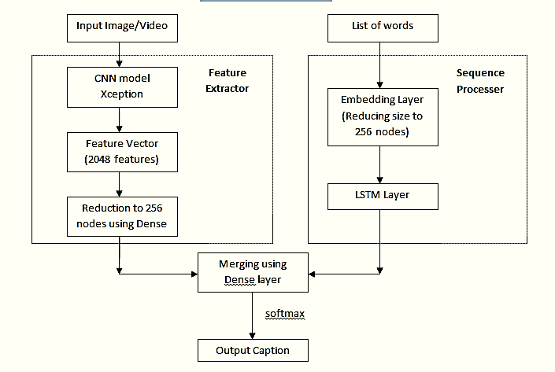
Architecture

Slide 20
Modules
Input Image
Feature Extraction
Caption Generation
Mapping
Encoding and Decoding[LSTM]
Image Captioning

Slide 21
Modules Cont’d
Input Image / Video
Resizing, normalization, cropping, and other transformations to prepare images for analysis.
Extraction of frames, temporal sampling, resizing, and other transformations.
Feature Extraction
Image Feature Extraction: CNN (Convolutional Neural Networks) models such as VGG is used to extract visual features from images.
Video Feature Extraction: Combining both spatial (frame-level) and temporal features using 3D CNNs, 2D CNNs with temporal processing, or pre-trained models like I3D (Inflated 3D ConvNet) for video analysis.

Slide 22
Modules Cont’d
Caption Generation
The part of the model responsible for generating captions based on the extracted features. This could be a recurrent neural network or a transformer-based architecture.
Handling the vocabulary of words used in captions, including tokenization and mapping between words and indices.
Mapping
Mapping typically refers to the process of associating visual features extracted from an image with corresponding textual descriptions. This involves learning a relationship between the visual content of an image and the natural language descriptions that describe it.

Slide 23
Modules Cont’d
Encoder and Decoder
The encoder processes the input image or video frames and extracts visual features.
These visual features are then passed to the decoder.
The decoder, conditioned on the visual features, generates a sequence of words to form the caption.
During training, the model learns to generate captions that are semantically and syntactically similar to the ground truth captions associated with the input images or video frames.
During inference, the trained model generates captions for new images or video frames.
Image and Video Captioning-Output
The output captions should ideally be descriptive, coherent, and contextually relevant to the visual content of the input image or video frames. They should capture both the visual features and the semantic meaning conveyed by the scene or events depicted.

Slide 24
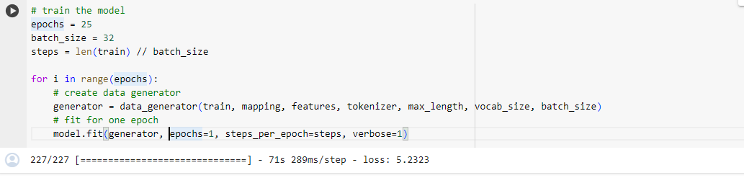
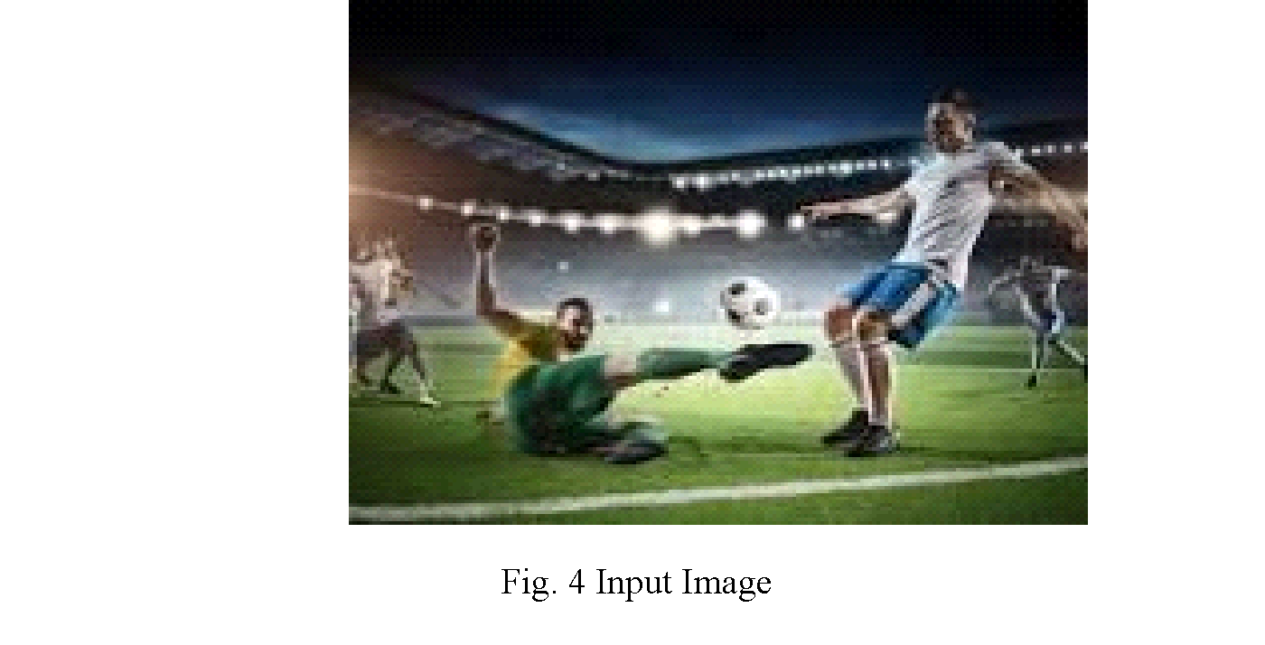
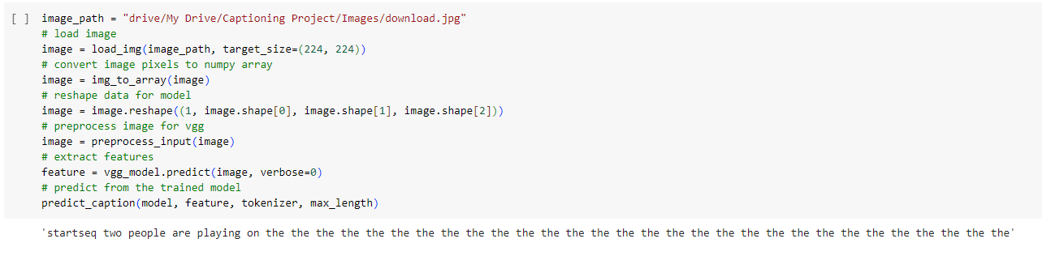
Output Screen Shots- Image Captioning
After one epoch model generated the caption as “two people are playing on the the the the the the the ……………….”

Slide 25
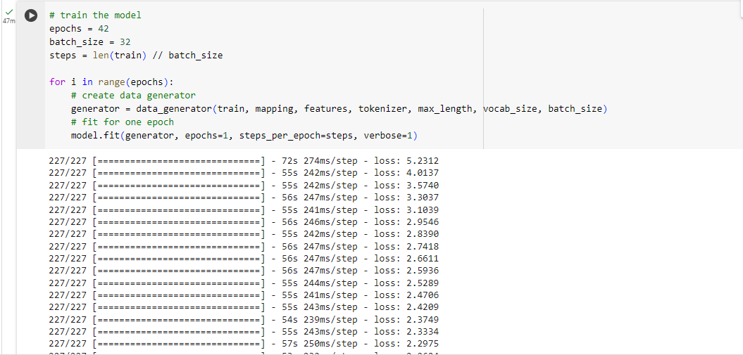
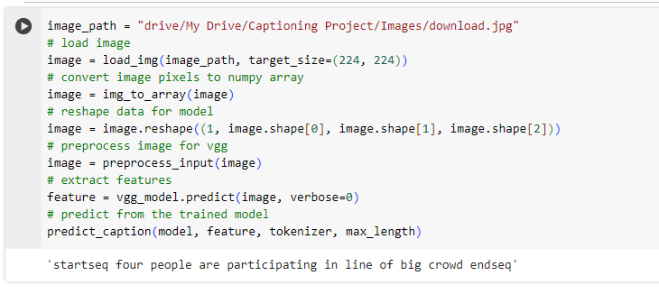
Output Screen Shots
After 42 epochs model generated the caption as “Four people are participating in line of big crowd”

Slide 26
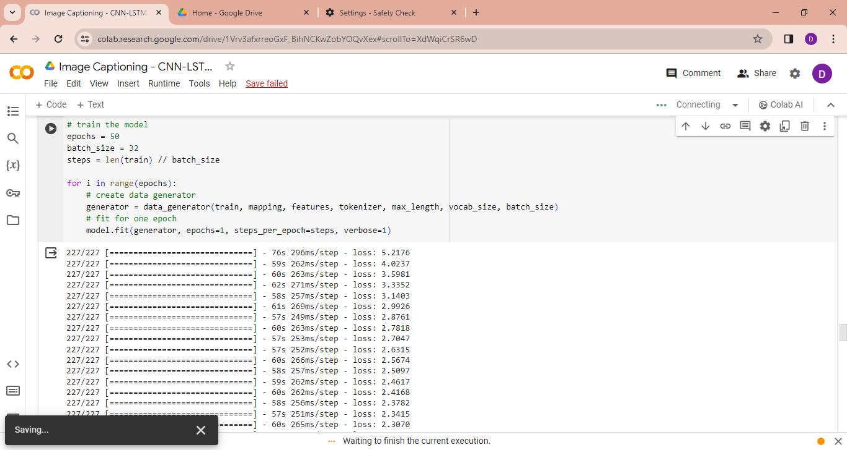
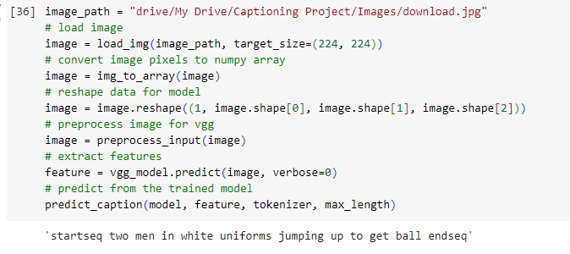
Output Screen Shots
After 50 epochs model generated the caption as “ Two men in white uniforms jumping up to get ball.”
 | Actul | Predicted | Final Score
BLEU-1 | 0.25 | 0.25 | 0.110477
BELU-2 | 0.5 | 0 | 0.293064
For BLEU Calculated Matrix results, [Image Captioning]

Slide 27
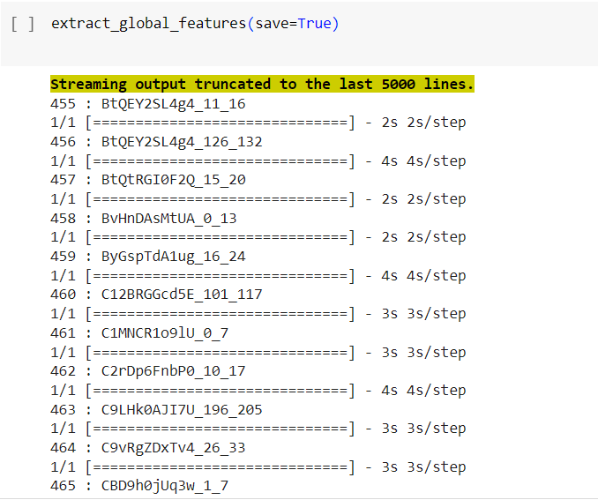
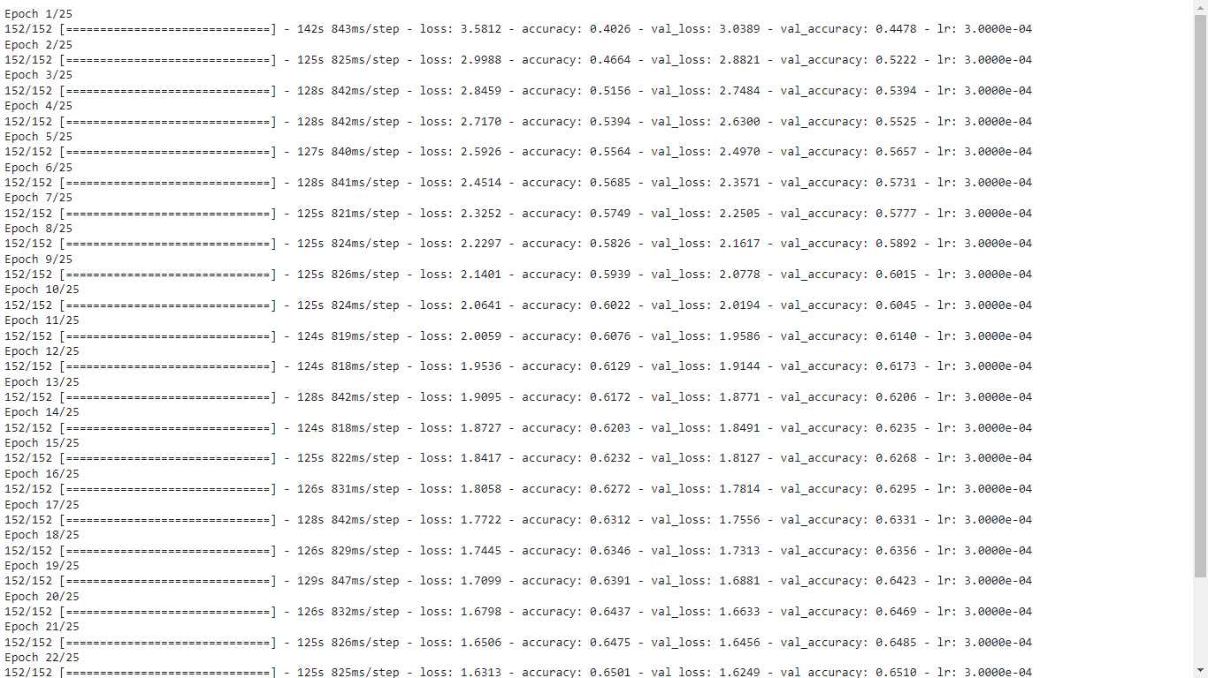
Output Screen Shots- Video Captioning
Epoch values for Video Captioning
Videos Converting into Frames

Slide 28
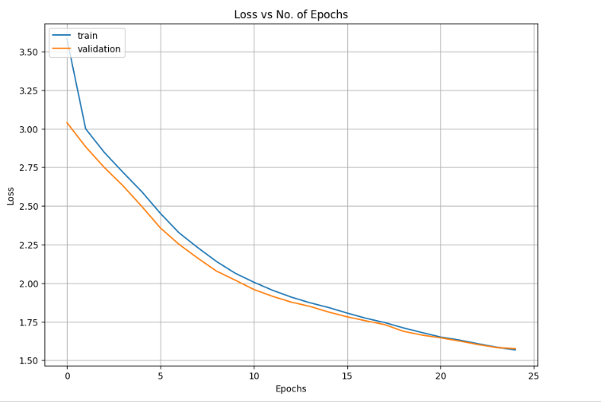
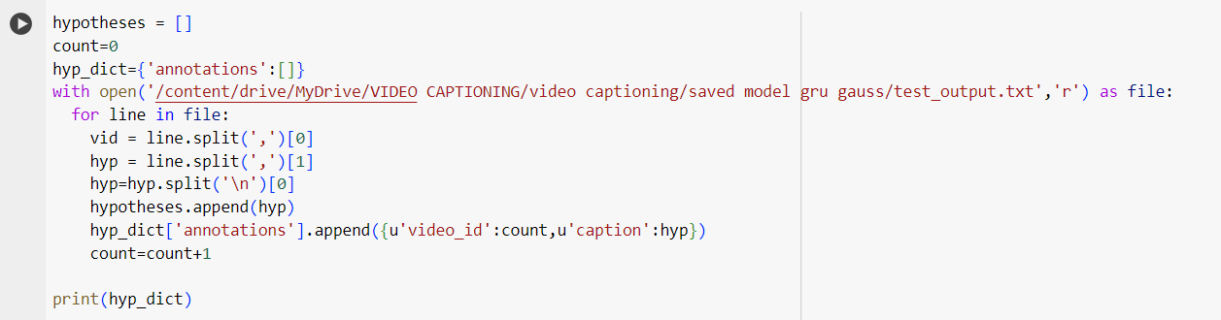
Output Screen Shots- Video Captioning
Video captioning Result
Graph for Loss vs. Epochs

Slide 29
Result Matrix for Video Captioning
Model | Bleu_1 | Bleu_2 | Bleu_3 | Bleu_4 | METEOR | ROUGE_L | CIDEr
CNN +LSTM | 0.641 | 0.438 | 0.330 | 0.241 | 0.206 | 0.568 | 0.302
Matrix’s for Video Captioning

Slide 30
Conclusion
The Hybrid CNN+LSTM model for image and video captioning has shown significant results in generating descriptive and contextually relevant captions. By combining the Convolutional Neural Networks (CNNs) for feature extraction and Long Short-Term Memory networks (LSTMs) for sequence generation, this approach has yielded impressive results in the field of computer vision and natural language processing. Through both qualitative and quantitative evaluations, the CNN+LSTM model has demonstrated its ability to produce captions that accurately describe the content of images or video frames. While CNNs are proficient at capturing spatial features, incorporating additional context-aware mechanisms could improve the model's understanding of the broader context surrounding the images or video frames. Its performance has been measured with the metrics, BLEU.

Slide 31
Future Work
The future work of this, Pre-trained CNNs and LSTMs on domain-specific datasets could lead to better performance, as the model learns to capture domain-specific features. Investigating techniques for integrating information from multiple modalities, such as text, audio, and motion, could lead to more comprehensive and informative captions, especially in the context of video captioning. The creation of larger and more diverse datasets specifically tailored for image and video captioning tasks could further enhance the performance and generalization capabilities of the model.

Slide 32
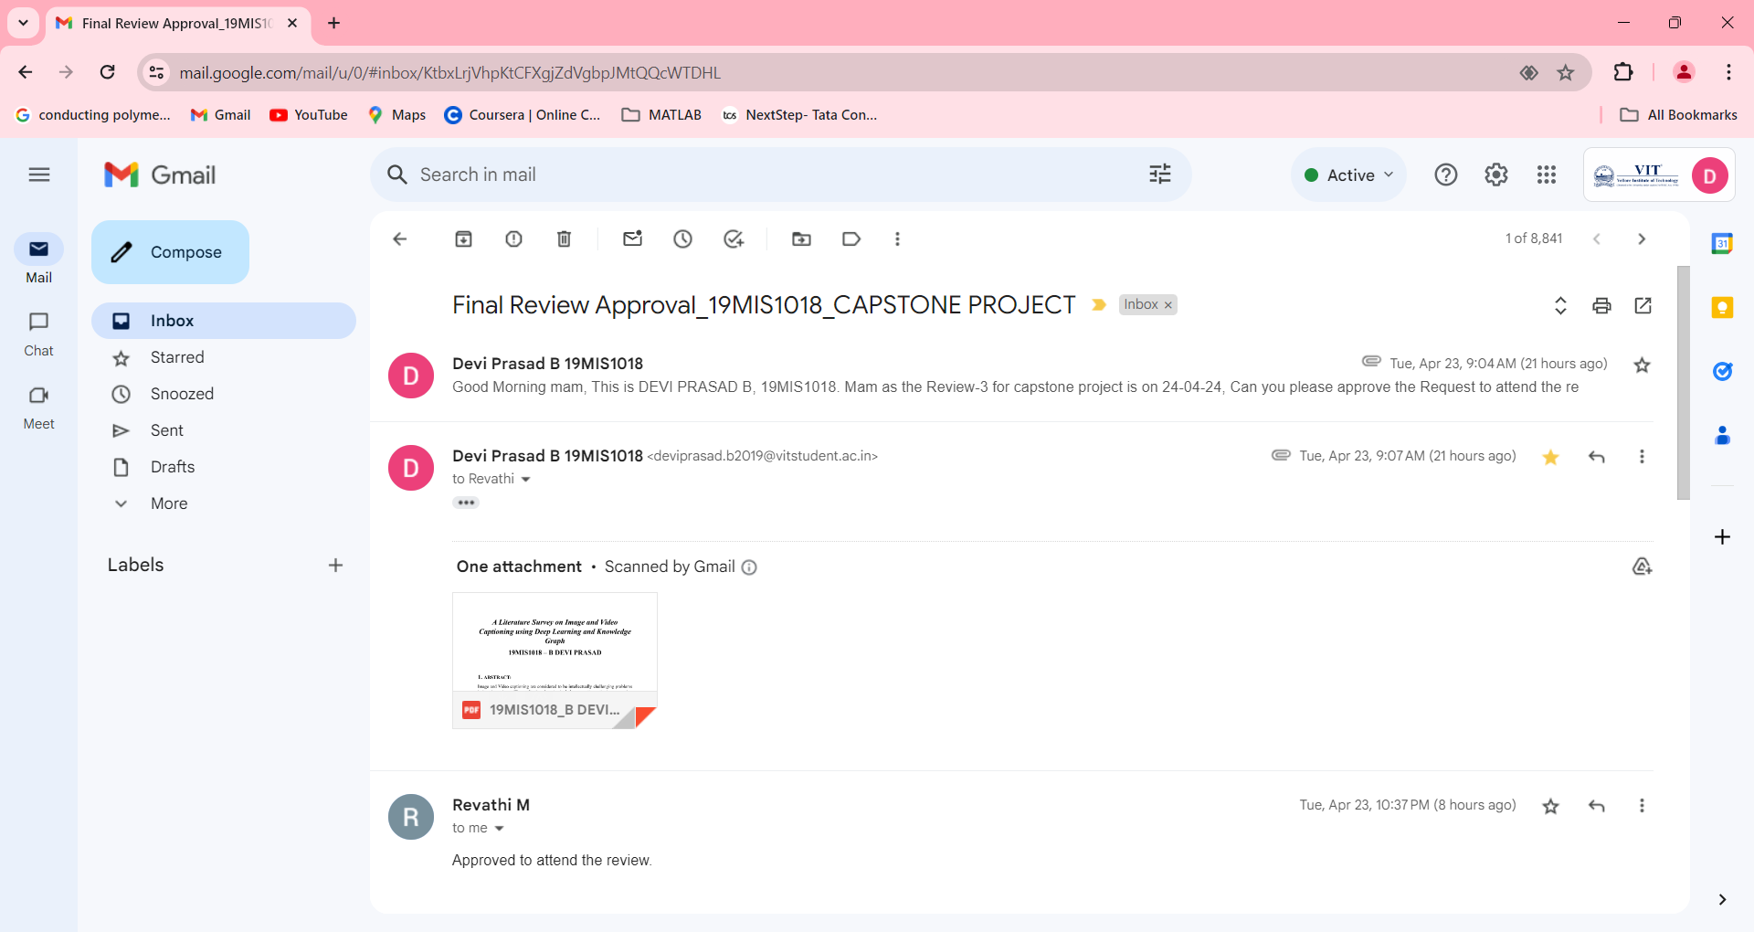
Guide Approval Mail

Slide 33
References
[1] S. Rohitharun, L. Uday Kumar Reddy, S. Sujana, Image captioning using CNN and RNN, in: 2022 2nd Asian Conference on Innovation in Technology (ASIANCON), Ravet, India, 2022, pp. 1–8
[2] A. Tripathi, M.K. Gupta, C. Srivastava, P. Dixit, S.K. Pandey, Object detection using YOLO: a survey, in: 2022 5th International Conference on Contemporary Computing and Informatics (IC3I), Uttar Pradesh, India, 2022, pp. 747–752.
[3] J. Jin, J. Ye, X. Lin, L. He, Pseudo-query generation for semi-supervised visual grounding with knowledge distillation, in: ICASSP 2023 - 2023 IEEE International Conference on Acoustics, Speech and Signal Processing (ICASSP), Rhodes Island, Greece, 2023.
[4] Ankit Kumar, Rakesh Kumar Yadav, DilipKumar Jang Bahadur Saini, Create and mplement a new method for robust video face recognition using convolutional neural network algorithm, e-Prime - advances in electrical engineering, Electron. Energy Volume 5 (2023)
[5] Aafaq, N., Mian, A., Liu, W., Gilani, S. Z., & Shah, M. (2019). Video description: A survey of methods, datasets, and evaluation metrics. ACM Computing Surveys (CSUR), 52(6), 1-37.

Slide 34
References
[6] Liu, W., Chen, S., Guo, L., Zhu, X., & Liu, J. Cptr: Full transformer network for image captioning. arXiv 2021. arXiv preprint arXiv:2101.10804.
[7] Nechikkat, M. I., Pattilikattil, B. V., Varma, S., & James, A. (2022, October). Video captioning using transformer network. In AIP Conference Proceedings (Vol. 2494, No. 1). AIP Publishing.
[8] Zhao, W., & Wu, X. (2023). Boosting entity-aware image captioning with multi-modal knowledge graph. IEEE Transactions on Multimedia.
[9] Verma, D., Haldar, A., & Dutta, T. (2023, June). Leveraging Weighted Cross-Graph Attention for Visual and Semantic Enhanced Video Captioning Network. In Proceedings of the AAAI Conference on Artificial Intelligence (Vol. 37, No. 2, pp. 2465-2473).
[10] Zhong, M., Chen, Y., Zhang, H., Xiong, H., & Wang, Z. (2023). Bidirectional transformer with knowledge graph for video captioning. Multimedia Tools and Applications, 1-20.

Slide 35
References
[11] S. Rohitharun, L. Uday Kumar Reddy and S. Sujana, "Image Captioning Using CNN and RNN," 2022 2nd Asian Conference on Innovation in Technology (ASIANCON), Ravet, India, 2022, pp. 1-8, doi: 10.1109/ASIANCON55314.2022.9909146.
[12] Li, Z., Wei, J., Huang, F., & Ma, H. (2023). Modeling graph-structured contexts for image captioning. Image and Vision Computing, 129, 104591.
[13] Zeng, P., Zhang, H., Gao, L., Li, X., Qian, J., & Shen, H. T. (2023). Visual commonsense-aware representation network for video captioning. IEEE Transactions on Neural Networks and Learning Systems.
[14] Yan, L., Han, C., Xu, Z., Liu, D., & Wang, Q. (2023, August). Prompt learns prompt: exploring knowledge-aware generative prompt collaboration for video captioning. In Proceedings of the Thirty-Second International Joint Conference on Artificial Intelligence (IJCAI). International Joint Conferences on Artificial Intelligence Organization. https://doi. org/10.24963/ijcai (Vol. 180).
[15] Yan, Z., Chen, Y., Song, J., & Zhu, J. (2023). Multimodal feature fusion based on object relation for video captioning. CAAI Transactions on Intelligence Technology, 8(1), 247-259.

Slide 36
Thankyou

